Slide 1
Chapter 19:
VIBRATIONS AND WAVES

Slide 2
This lecture will help you understand:
Vibrations of a Pendulum
Wave Description
Wave Speed
Transverse Waves
Longitudinal Waves
Wave Interference
Standing Waves
Doppler Effect
Bow Waves
Shock Waves

Slide 3
Good Vibrations
A vibration is a periodic wiggle in time.
A periodic wiggle in both space and time is a wave. A wave extends from one place to another. Examples are:
  light, which is an electromagnetic wave that needs no medium.
  sound, which is a mechanical wave that needs a medium.

Slide 4
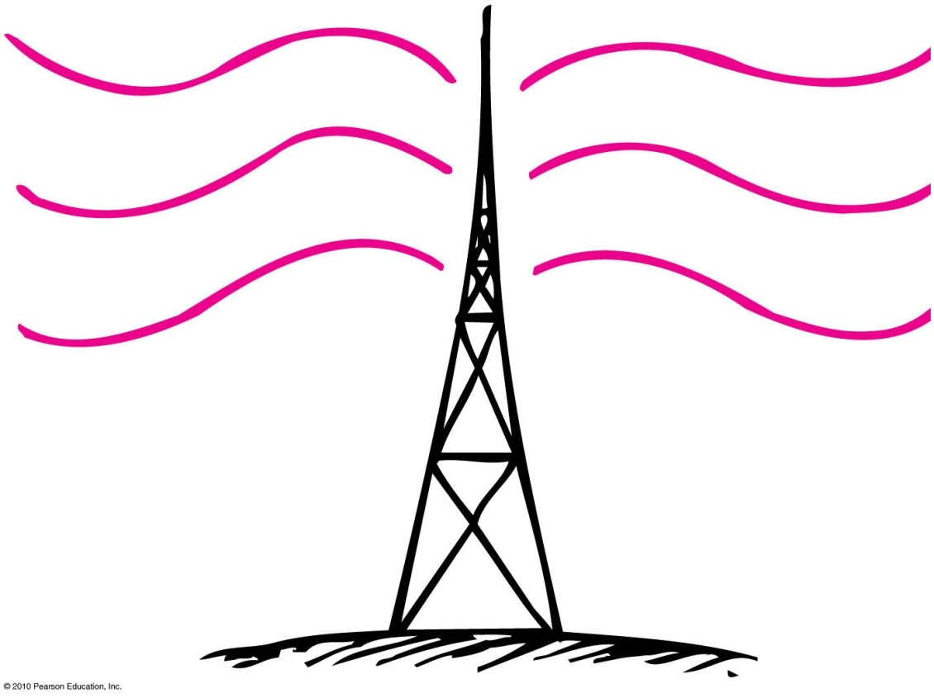
Vibrations and Waves
Vibration
Wiggle in time
Wave
Wiggle in space and time

Slide 5
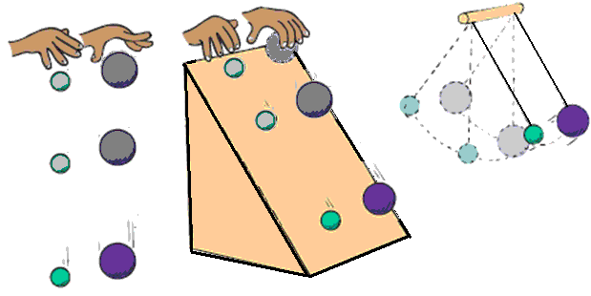
Vibrations of a Pendulum
If we suspend a stone at the end of a piece of string, we have a simple pendulum.
The pendulum swings to and fro at a rate that
  depends only on the length of the pendulum.
  does not depend upon the mass (just as mass does not affect the rate at which a ball falls to the ground).

Slide 6
Vibrations of a Pendulum
The time of one to-and-fro swing is called the period.
The longer the length of a pendulum, the longer the period (just as the higher you drop a ball from, the longer it takes to reach the ground).

Slide 7
Vibration of a Pendulum
Galileo discovered that the time a pendulum takes to swing to and fro depends only on the length of the pendulum.
The period, T, is the time it takes to make one complete to and fro swing.
T = 2π (l / g)^{1/2} where l is the length of the pendulum and g is the gravitational acceleration, 9.8 m / s².
The period is independent of the mass or size (height) of the arc.
Pendulums have been used to sense difference in g or the gravitational attraction.

Slide 8
A 1-meter-long pendulum has a bob with a mass of 1 kg. Suppose that the bob is now replaced with a different bob of mass 2 kg, how will the period of the pendulum change?
Vibrations of a Pendulum
CHECK YOUR NEIGHBOR
A. It will double.
It will halve.
It will remain the same.
There is not enough information.
Notes:
C. It will remain the same.

Slide 9
A 1-meter-long pendulum has a bob with a mass of 1 kg. Suppose that the bob is now replaced with a different bob of mass 2 kg, how will the period of the pendulum change?
Vibrations of a Pendulum
CHECK YOUR ANSWER
A. It will double.
It will halve.
It will remain the same.
There is not enough information.
Explanation:
The period of a pendulum depends only on the length of the pendulum, not on the mass. So changing the mass will not change the period of the pendulum.
Notes:
C. It will remain the same.

Slide 10
A 1-meter-long pendulum has a bob with a mass of 1 kg. Suppose that the bob is now tied to a different string so that the length of the pendulum is now 2 m. How will the period of the pendulum change?
Vibrations of a Pendulum
CHECK YOUR NEIGHBOR
A. It will increase.
It will decrease.
It will remain the same.
There is not enough information.
Notes:
A. increases.

Slide 11
A 1-meter-long pendulum has a bob with a mass of 1 kg. Suppose that the bob is now tied to a different string so that the length of the pendulum is now 2 m. How will the period of the pendulum change?
Vibrations of a Pendulum
CHECK YOUR ANSWER
A. It will increase.
It will decrease.
It will remain the same.
There is not enough information.
Explanation:
The period of a pendulum increases with the length of the pendulum.
Notes:
A. increases.

Slide 12
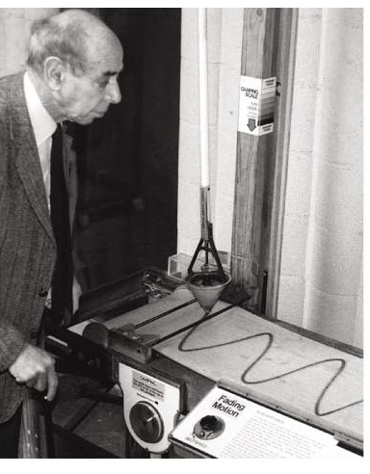
Wave Description
A wave is pictorially represented by a sine curve.
A sine curve is obtained when you trace out the path of a vibrating pendulum over time.
  Put some sand in the pendulum and let it swing.
  The sand drops through a hole in the pendulum onto a sheet of paper.
  As the pendulum swings back and forth, pull the sheet of paper on which the sand falls.
  The sand makes a sine curve on the paper.

Slide 13
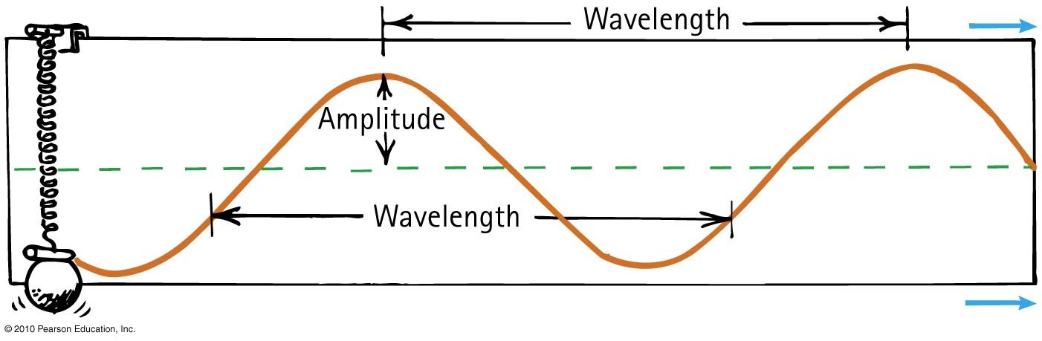
Wave Description
When a bob vibrates up and down, a marking pen traces out a sine curve on the paper that moves horizontally at constant speed.
The up and down or oscillatory motion of a spring is called simple harmonic motion where the restoring force is proportional to the displacement from equilibrium. Hooke’s Law, F = k Δx.

Slide 14
Wave Description
Vibration and wave characteristics
Crests - high points of the wave
Troughs - low points of the wave

Slide 15
Wave Description
Vibration and wave characteristics (continued)
Amplitude - distance from the midpoint to the crest or to the trough
Wavelength -distance from the top of one crest to the top of the next crest, or distance between successive identical parts of the wave
Frequency - the number of vibrations per unit time. Given is cycles per seconds or hertz (hz).

Slide 16
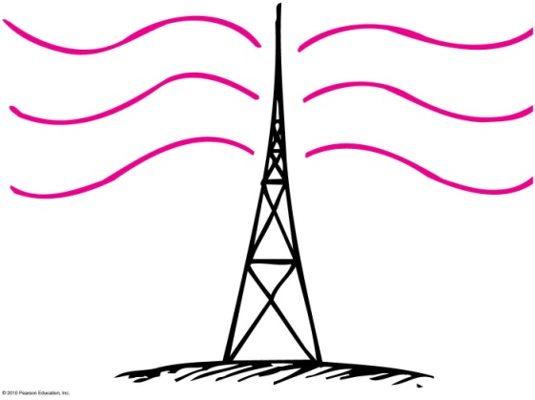
Wave Description
How frequently a vibration occurs is called the frequency.
The unit for frequency is Hertz (Hz), after Heinrich Hertz
A frequency of 1 Hz is a vibration that occurs once each second.
Mechanical objects (e.g., pendulums) have frequencies of a few Hz.
Sound has a frequency of a few 100 or 1000 Hz.
Radio waves have frequencies of a few million Hz (MHz).
Cell phones operate at few billon Hz (GHz).

Slide 17
Wave Description
Frequency
Specifies the number of to and fro vibrations in a given time
Number of waves passing any point per second
  Example: 2 vibrations occurring in 1 second is a frequency of 2 vibrations per second.

Slide 18
Wave Description
Period
Time to complete one vibration
or, vice versa,
Example: Pendulum makes 2 vibrations in 1 second. Frequency is 2 Hz. Period of vibration is ¹⁄₂ second.
1
Period =
frequency
1
Frequency =
period

Slide 19
A sound wave has a frequency of 500 Hz. What is the period of vibration of the air molecules due to the sound wave?
Wave Description
CHECK YOUR NEIGHBOR
A. 1 s
0.01 s
0.002 s
0.005 s
Notes:
C. 0.002 s

Slide 20
A sound wave has a frequency of 500 Hz. What is the period of vibration of the air molecules due to the sound wave?
Wave Description
CHECK YOUR ANSWER
Explanation:
A. 1 s
0.01 s
0.002 s
0.005 s
1
Period =
frequency
So:
1
Period =
= 0.002 s
500 Hz
Notes:
C. 0.002 s

Slide 21
If the frequency of a particular wave is 20 Hz, its period is
Wave Description
CHECK YOUR NEIGHBOR
A. ¹/₂₀ second.
20 seconds.
more than 20 seconds.
None of the above.
Notes:
A. ¹/₂₀ second.

Slide 22
If the frequency of a particular wave is 20 Hz, its period is
Wave Description
CHECK YOUR ANSWER
A. ¹/₂₀ second.
20 seconds.
more than 20 seconds.
None of the above.
Explanation:
Note when ƒ = 20 Hz, T = 1/ƒ = 1/(20 Hz) = ¹/₂₀ second.
Notes:
A. ¹/₂₀ second.

Slide 23
What is the frequency, in hertz, that corresponds to each of the following periods?
(a) 0.10 s, f = 1 / 0.10 = 10 Hz;
(b) 5 s, f = 1 / 0.5 = 20 Hz;
(c)1/60s, f = 1/ (1/60) = 60 Hz.
2. What is the period, in seconds, that corresponds to each of the following frequencies?
(a) 10 Hz, T = 1/10 = 0.1 s;
(b) 0.2 Hz, T = 1/ 0.2 = 5 s;
(c) 60 Hz, T = 1/ 60 = 0.0197s:

Slide 24
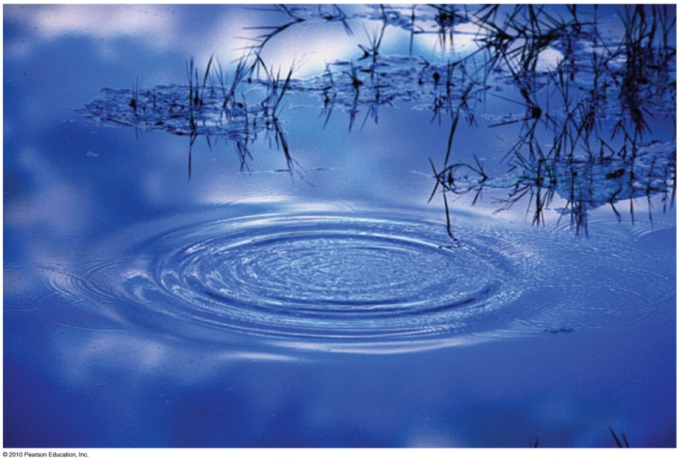
Wave Motion
Wave motion
Waves transport energy and not matter.
Example:
  Drop a stone in a quiet pond and the resulting ripples carry no water across the pond.
  Waves travel across grass on a windy day.
  Molecules in air propagate a disturbance through air.

Slide 25
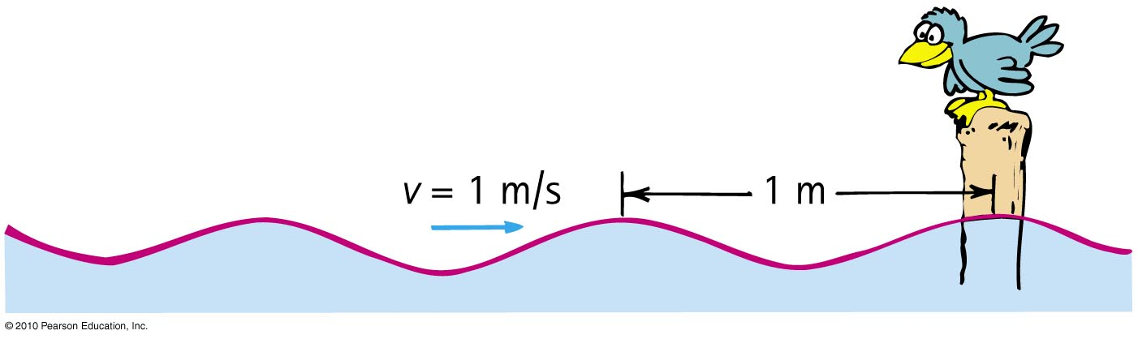
Wave Motion
Wave speed
Describes how fast a disturbance moves through a medium
Related to frequency and wavelength of a wave
Example:
  A wave with wavelength 1 meter and frequency of
  1 Hz has a speed of 1 m/s.
Wave speed = frequency × wavelength

Slide 26
A wave with wavelength 10 meters and time between crests of 0.5 second is traveling in water. What is the wave speed?
Wave Speed
CHECK YOUR NEIGHBOR
0.1 m/s
2 m/s
5 m/s
20 m/s
Notes:
D. 20 m/s

Slide 27
A wave with wavelength 10 meters and time between crests of 0.5 second is traveling in water. What is the wave speed?
Wave Speed
CHECK YOUR ANSWER
0.1 m/s
2 m/s
5 m/s
20 m/s
1
Explanation:
Frequency =
period
So:
1
Frequency =
= 2 Hz
0.5 s
Also:
Wave speed = frequency × wavelength
So:
Wave speed = 2 Hz × 10 m = 20 m/s
Notes:
D. 20 m/s

Slide 28
3. A skipper on a boat notices wave crests passing his anchor chain every 5 s. He estimates the distance between wave crests to be 15 m. He also correctly estimates the speed of the waves. What is this speed?
Wave speed = wavelength / period = 15 m / 5 s = 3 m/s.
4. A weight suspended from a spring is seen to bob up and down over a distance of 20 cm twice each second. What is its frequency? Its period? Its amplitude?
Frequency = cycles / second = 2 Hz
Period = 1/frequency = ½ = 0.5 second.
Amplitude = 20 cm

Slide 29
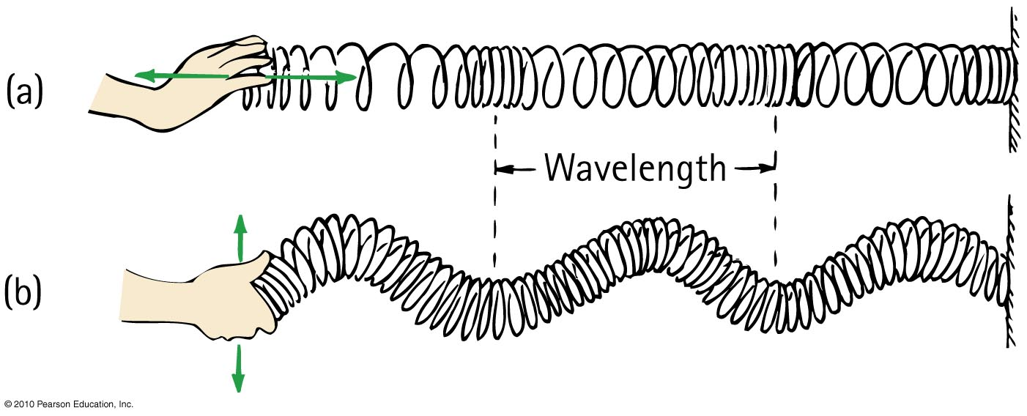
Transverse and Longitudinal Waves
Two common types of waves that differ because of the direction in which the medium vibrates compared with the direction of travel:
  longitudinal wave
  transverse wave

Slide 30
Transverse Waves
Transverse wave
Medium vibrates perpendicularly to direction of energy transfer
Side-to-side movement
Example:
  Vibrations in stretched strings of musical instruments
  Radio waves
  Light waves
  S-waves that travel in the ground (providing geologic information)

Slide 31
The distance between adjacent peaks in the direction of travel for a transverse wave is its
Transverse Waves
CHECK YOUR NEIGHBOR
A. frequency.
period.
wavelength.
amplitude.
Notes:
C. wavelength.

Slide 32
The distance between adjacent peaks in the direction of travel for a transverse wave is its
Transverse Waves
CHECK YOUR ANSWER
A. frequency.
period.
wavelength.
amplitude.
Explanation:
The wavelength of a transverse wave is also the distance between adjacent troughs, or between any adjacent identical parts of the waveform.
Notes:
C. wavelength.

Slide 33
The vibrations along a transverse wave move in a direction
Transverse Waves
CHECK YOUR NEIGHBOR
A. along the wave.
perpendicular to the wave.
Both A and B.
Neither A nor B.
Notes:
B. perpendicular to the wave.

Slide 34
The vibrations along a transverse wave move in a direction
Transverse Waves
CHECK YOUR ANSWER
A. along the wave.
perpendicular to the wave.
Both A and B.
Neither A nor B.
Comment:
The vibrations in a longitudinal wave, in contrast, are along (or parallel to) the direction of wave travel.
Notes:
B. perpendicular to the wave.

Slide 35
Longitudinal Waves
Longitudinal wave
Medium vibrates parallel to direction of energy transfer
Backward and forward movement
consists of
  compressions (wave compressed)
  rarefactions (stretched region between compressions)
  Example: sound waves in solid, liquid, gas

Slide 36
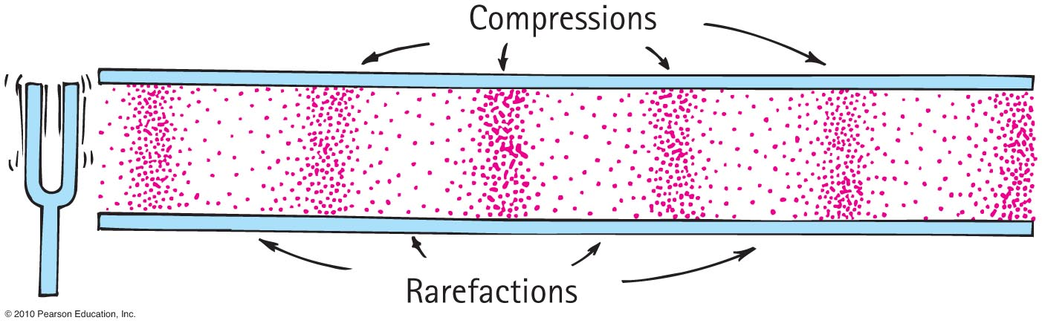
Longitudinal Waves
Longitudinal wave
  Example:
  sound waves in solid, liquid, gas
  P-waves that travel in the ground (providing geologic information)

Slide 37
The wavelength of a longitudinal wave is the distance between
Longitudinal Waves
CHECK YOUR NEIGHBOR
A. successive compressions.
successive rarefactions.
Both A and B.
None of the above.
Notes:
C. Both A and B.

Slide 38
The wavelength of a longitudinal wave is the distance between
Longitudinal Waves
CHECK YOUR ANSWER
A. successive compressions.
successive rarefactions.
Both A and B.
None of the above.
Notes:
C. Both A and B.

Slide 39
Wave Interference
Wave interference occurs when two or more waves interact with each other because they occur in the same place at the same time.
Superposition principle: The displacement due the interference of waves is determined by adding the disturbances produced by each wave.

Slide 40
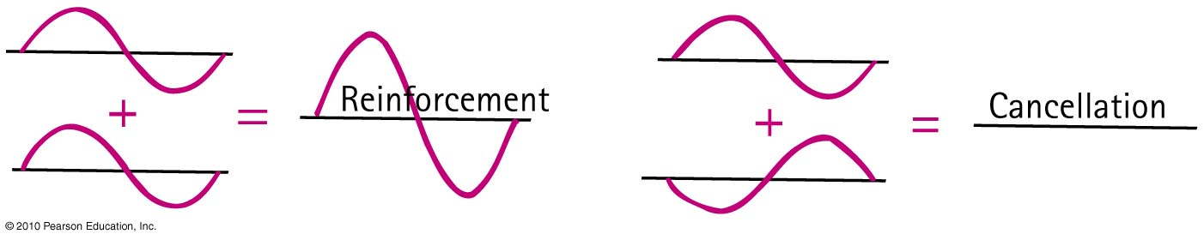
Wave Interference
Constructive interference : When the crest of one wave overlaps the crest of another, their individual effects add together to produce a wave of increased amplitude.
Destructive interference: When the crest of one wave overlaps the trough of another, the high part of one wave simply fills in the low part of another. So, their individual effects are reduced (or even canceled out).

Slide 41
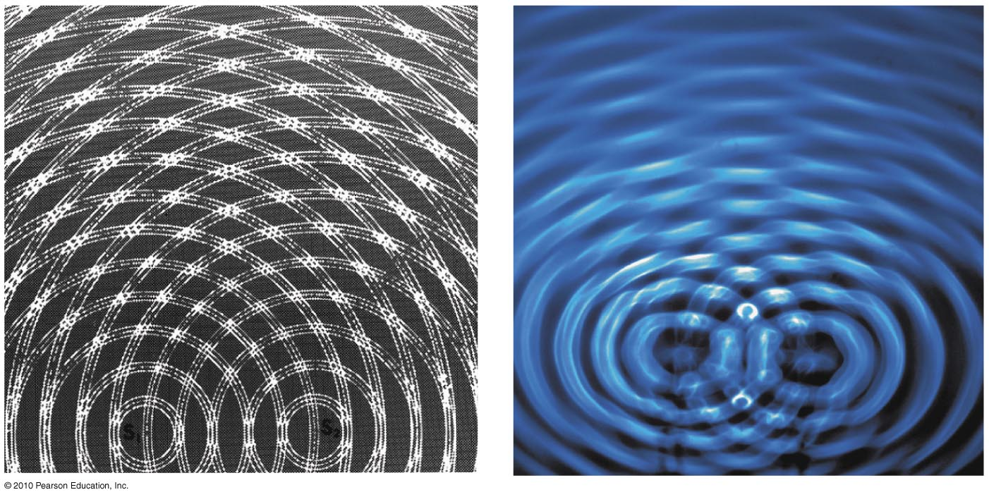
Wave Interference
Example:
We see the interference pattern made when two vibrating objects touch the surface of water.
The regions where a crest of one wave overlaps the trough of another to produce regions of zero amplitude.
At points along these regions, the waves arrive out of step, i.e., out of phase with each other.

Slide 42
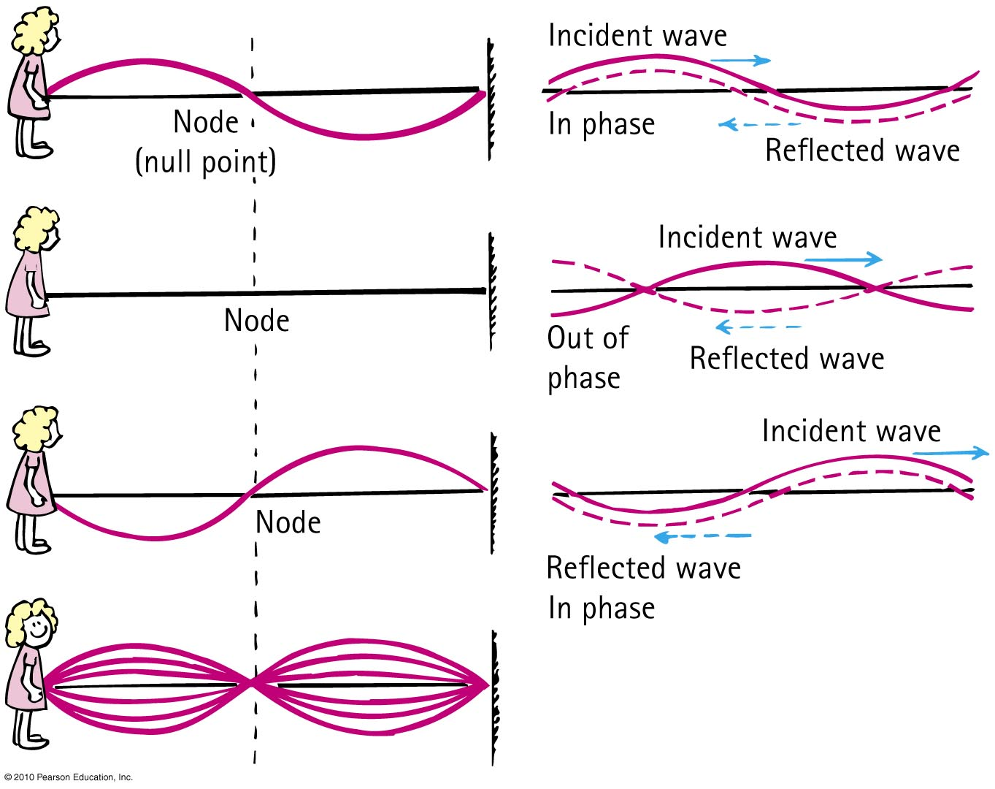
Standing Waves
If we tie a rope to a wall and shake the free end up and down, we produce a train of waves in the rope.
The wall is too rigid to shake, so the waves are reflected back along the rope.
By shaking the rope just right, we can cause the incident and reflected waves to form a standing wave.

Slide 43
Standing Waves
Nodes are the regions of minimal or zero displacement, with minimal or zero energy.
Antinodes are the regions of maximum displacement and maximum energy.
Antinodes and nodes occur equally apart from each other.

Slide 44
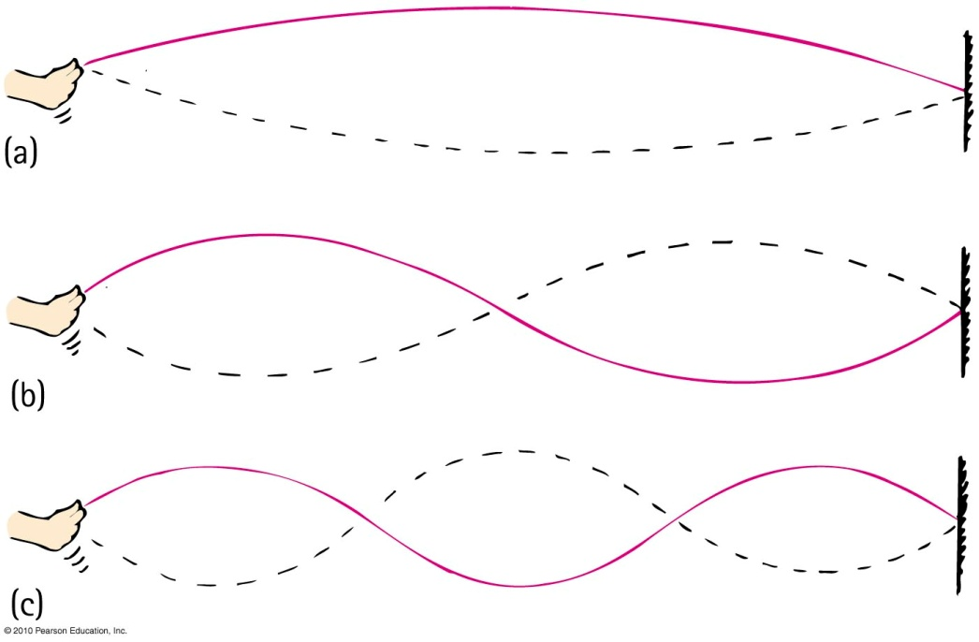
Standing Waves
Tie a tube to a firm support. Shake the tube from side to side with your hand.
If you shake the tube with the right frequency, you will set up a standing wave.
If you shake the tube with twice the frequency, a standing wave of half the wavelength, having two loops results.
If you shake the tube with three times the frequency, a standing wave of one-third the wavelength, having three loops results.

Slide 45
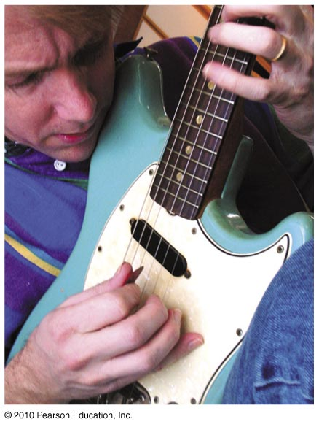
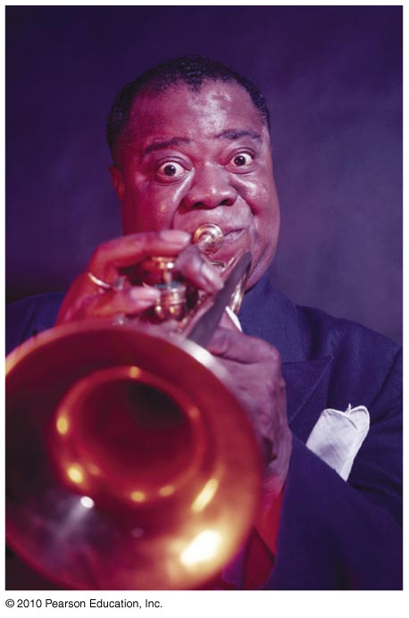
Standing Waves
Examples:
  Waves in a guitar string
  Sound waves in a trumpet

Slide 46
Doppler Effect
When the source or receiver of a wave is moving toward or away from each other the apparent or sensed frequency is different than the emitted frequency.
If the source or receiver are moving toward each other the frequency is increased.
If the source or receiver are moving away from each other the frequency is decreased.
The Doppler effect (Christian Doppler) also occurs for electromagnetic waves.

Slide 47
Doppler Effect
Doppler effect of light
  Blue shift: increase in light frequency toward the blue end of the spectrum
  Red shift: decrease in light frequency toward the red end of the spectrum
  Star’s spin speed can also be determined by shift measurement.
  Example: Rapidly spinning star shows a red shift on the side facing away from us and a blue shift on the side facing us.

Slide 48
The Doppler effect occurs for
The Doppler Effect
CHECK YOUR NEIGHBOR
A. sound.
light.
Both A and B.
Neither A nor B.
Notes:
C. both A and B.

Slide 49
The Doppler effect occurs for
The Doppler Effect
CHECK YOUR ANSWER
A. sound.
light.
Both A and B.
Neither A nor B.
Explanation:
The Doppler effect occurs for both sound and light. Astronomers measure the spin rates of stars by the Doppler effect.
Notes:
C. both of the above.

Slide 50
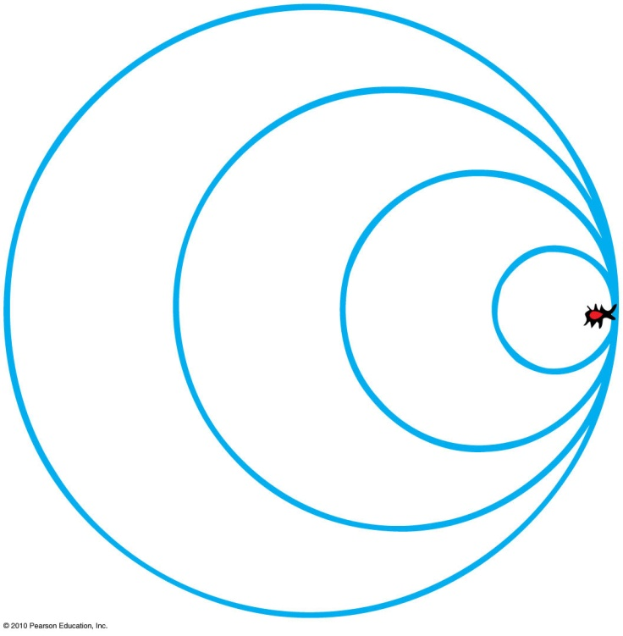
Bow Waves
Wave barrier
Waves superimpose directly on top of one another producing a “wall”.
Example: bug swimming as fast as the wave it makes

Slide 51
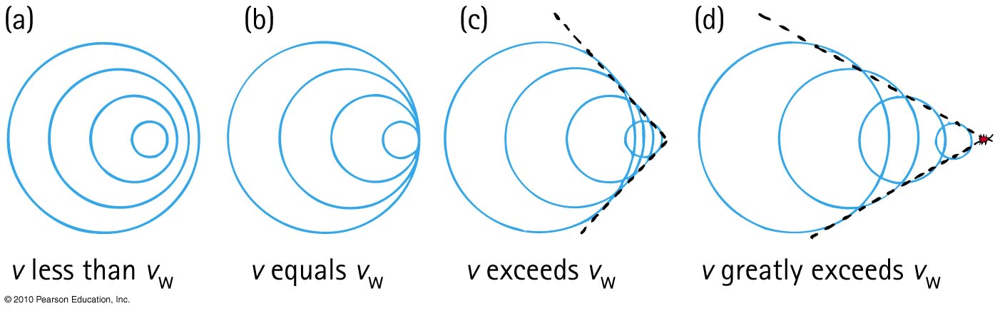
Bow Waves
Supersonic
Aircraft flying faster than the speed of sound.
Bow wave
V-shape form of overlapping waves when object travels faster than wave speed.
An increase in speed will produce a narrower V-shape of overlapping waves.

Slide 52
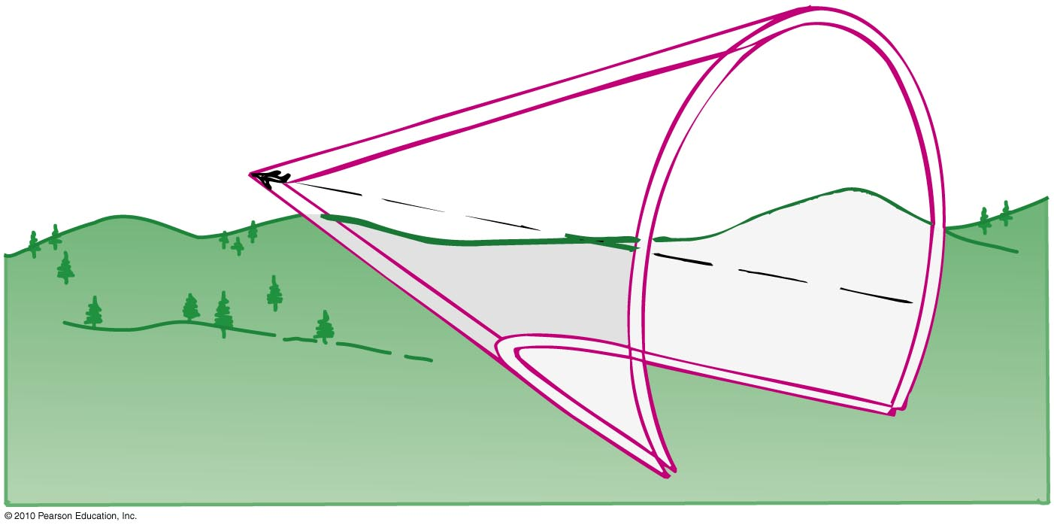
Shock Waves
Shock wave
Pattern of overlapping spheres that form a cone from objects traveling faster than the speed of sound.

Slide 53
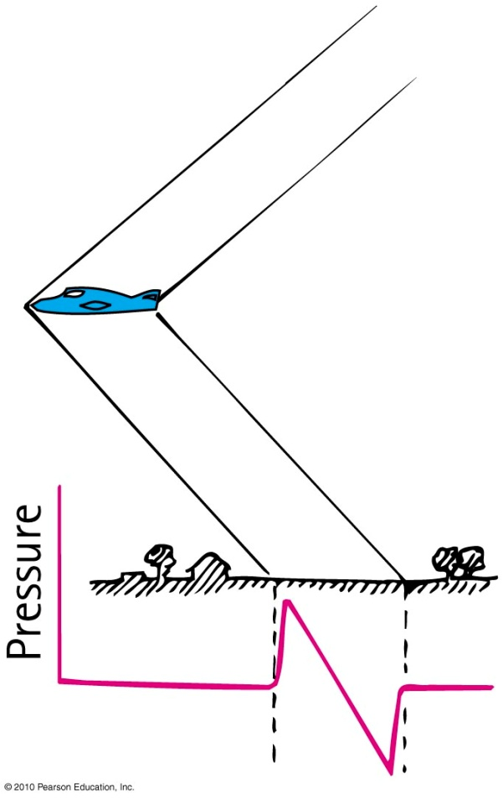
Shock Waves
Shock wave (continued)
Consists of two cones.
  a high-pressure cone generated at
  the bow of the supersonic aircraft
  a low-pressure cone that follows
  toward (or at) the tail of the aircraft
It is not required that a moving source be noisy.

Slide 54
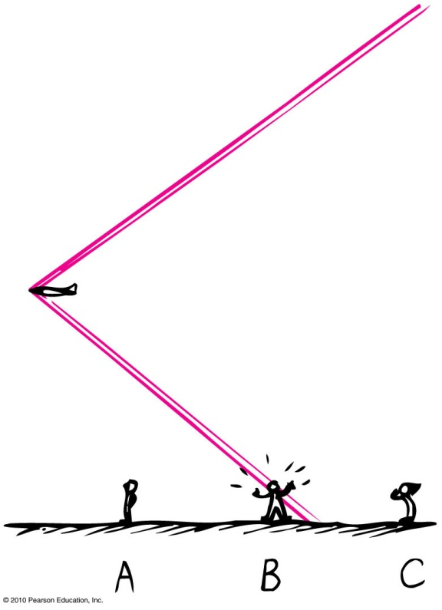
Shock Waves
Sonic boom
Sharp cracking sound generated by a supersonic aircraft
Intensity due to overpressure and underpressure of atmospheric pressure between the two cones of the shock waves
Produced before it broke the
sound barrier
Example:
  supersonic bullet
  crack of circus whip

